Slide 1
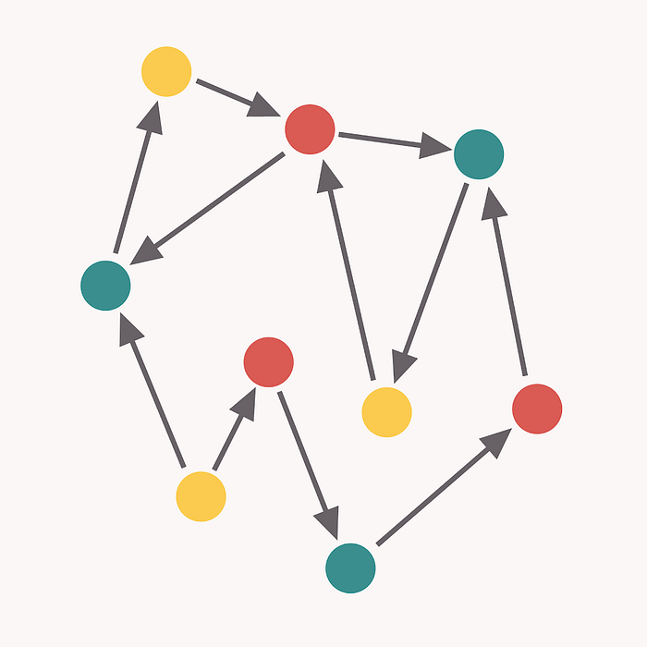
Cohesion & Coupling in Python

Slide 2
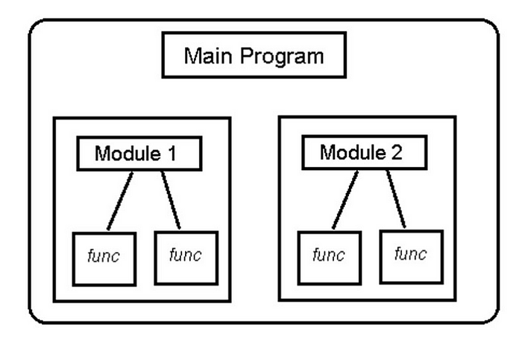
Introduction
Modular programming (according to Wikipedia) is a software design technique that emphasizes separating the functionality of a program into independent, interchangeable modules, such that each contains everything necessary to execute only one aspect of the desired functionality. This means that if you are not writing the new Star Wars Movie script, and if you are developing software, you do not write the whole software script in one file like the Iliad. By dividing the whole concept into smaller parts, modules, you deal with them separately and construct the communication of these modules with each other while creating the whole.
Notes:
This is a straightforward solution for calculating the average of 2 numbers.
Notice the code in lines 3-5, repeated in lines 7-9.

Slide 3
Modularization
The main purpose of modularization is to make the software project simpler and more manageable and scalable. Let’s modulate the benefits:
Your code will be easier to read. Code blocks will become smaller and narrower, therefore it will be easier to understand what they do in a narrow sense, and what is their role in the bigger picture.
You will test your code easily. The function volumes will be smaller, it will be easier to write and manage the tests. Since you deal with the small parts in the whole closely, a much more detailed test will be implemented in total.
In fact, since we also categorize the responsibilities in modularization, you will be able to easily access a code snippet or function that you are looking for.
Reusability. You will not need to write the same code again and again. Just take the one you have already written, and use it somewhere else.
If a function is problematic, then you will just fix that specific function. You do not need to visit all parts of the software which are using this function.
It will be very easier to refactor your code. Besides, it will be easier to work together with team members. Each person can work on a different module, etc.
Coupling and cohesion are two higher-level terms that we should consider when constructing the inter-module and intra-module structure in a software design. They give information about how easily your code can be changed or extended.
Notes:
This is a straight forward solution for calculating the average of 10 numbers.
Notice now the code in lines 4-6 repeated more than once (3 times to be exact).
In real life, the size of data that programs deal with, is generally huge.
For example:
Bank system calculations
Seeking information on the web.
Image processing
Network traffic monitoring
etc…
It would be impractical to repeat the same few commands dozens, or hundreds or thousands of times.
Programs would become unreadable, error-prone and hard to fix.
There must be another solution for the repetition-of-similar-or-same-code problem!

Slide 4
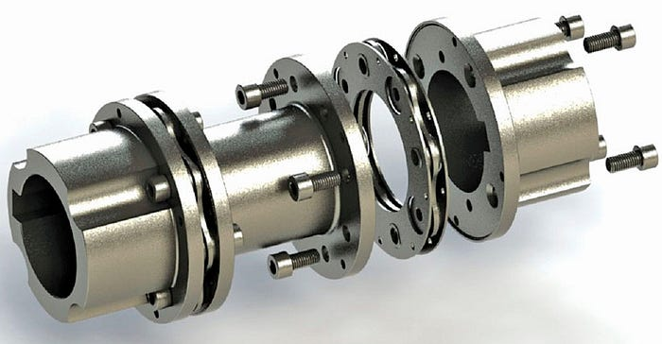
Coupling
Coupling is the degree of interdependence between software modules. It specifies how much information one class has about another class. If information is transferred from one class to another directly, we can say that coupling is tight here, however, if there is an interface between them, then we can say that it is loosely coupled. We should make our structure as loosely as possible.
Having high coupling is problematic because changing something in one part of your program means you need to change things in multiple places. Of course, there will be some portion of coupling in your code because various parts of your program need to work together, but the more coupling you introduce, the more complicated things will be.

Slide 5
Content coupling
Cases where classes are dependent on each other’s internal structures & their implementations, happen because of wrong abstractions. It creates the problem of updating / changing together. A change in one causes a change in the other one. As the program grows, this problem becomes inextricable.
In the example below, if we change KeyReader class, we have to change related Console behaviors since they are linked to each other.
from abc import ABC, abstractmethod from dataclasses import dataclass @dataclass class KeyReader: no_key: bool key_inside = bool key_turned = bool key_ejected = bool class Console(): def __init__(self): self.state = "ON" self.status = None def service(self, state): K = KeyReader() while self.state == "ON": self.status = K.no_key # ...
Notes:
A loop is a mechanism for defining the repetition of a code segment.
Each repetition is called an Iteration.
In this chapter we will learn about the following loop types:
The while loop
The for loop
These are not the only loop types in Python, but they are very common in most programming languages.

Slide 6
Content coupling – cont’d
Common coupling: Dependencies on global data and variables. If you change the global variable, everything related will be affected.
External coupling: If the component or system they use in common along the structures imposes format, interface, data structure, etc, this will cause external coupling.
Control coupling: A dependency in which structures control each other’s flows by passing flags. It is a special case of data coupling.
Data-structured coupling: It is the dependency that structures create by passing complex data structures to each other. What is sent is a data structure, not an object.
Data coupling: It is the dependency that structures create by passing primitive data to each other, for example, integers. It is a simpler version of data-structured coupling. Passing too many parameters to a method is a common symptom of this coupling.
Notes:
The while keyword indicates the use of the while loop.
A condition is checked.
If the condition evaluates to true, a block of commands (enclosed in braces) is executed.
When the program is done executing the block, the condition is checked again.
The block will be executed again and again, as long as the condition
evaluates to true.
As soon as the condition turns to false the block is skipped.

Slide 7
Content coupling – cont’d
Message coupling: Best case. It is a form of coupling that does not require any knowledge other than the interface of an object. The coupling must be over the interfaces of the methods, methods that the classes offer to each other.
Objects with message coupling provide services to each other, data remains only as material in the provision of this service. There is no direct access to the data. That is, it is not an exchange of data, it is an exchange of services.
No coupling: There is no coupling. Completely different units.
There are other coupling types in OOP:
Inheritance coupling: is-a coupling.
Abstract coupling: coupling to abstract classes. Can be both is-a and has-a coupling (polymorphism).
Notes:
Syntax
while 'condition': //colons at the end of the line to determine the beginning of the loop scope
one or more commands //in a slight indentation to the right
…
The slight indentation to the right defines all the commands meant for repetition into a
repeating block called the loop block (also known as loop body).
Action
The loop continues to iterate as long as the value of the condition is true.
The condition is re-evaluated before each repetition of the loop block.
In this case the condition is (number < 1000) and the loop block is in lines 3-4.
Important
Consider a loop in action.
What makes it stop?
If the program is executing the code in the loop, will it do so “forever”?
For the program to eventually exit the loop the condition must be false at some point.

Slide 8

Cohesion
Cohesion is the extent to which two or more parts of a system are related and how they work together to create something more valuable than the individual parts. “The whole is greater than the sum of the parts.”. We definitely want more cohesive structures.
A strong cohesive structure has a clear responsibility, it is being focused on a single task. Single responsibility in Solid principles is actually about how cohesive we are, and how high or low the level of cohesion is. Each part of the design addresses a separate concern, a set of information that affects the code of a computer program. If all the structures and functions of a class are for the same common purpose, the cohesion of that class is high.
Notes:
The loop block (lines 3-7) consist of:
The commands the programmer wishes to repeat (lines 4-7)
Commands to make changes that will eventually turn the condition from true to false (line 7)
Now that we have the while loop in place, changing the number of times it is repeated (iterates) is very easy.
All we need to do is the change the condition (in this case, line 3) accordingly.
No change in the loop block is needed.

Slide 9
Coincidental cohesion
No conceptual relationship between elements. It is accidental and the worst form of cohesion. This one is very common in utility classes. For example, in the class below, there are unrelated methods together.
from abc import ABC, abstractmethod class Utility(ABC): @abstractmethod def check_currency(self): pass @abstractmethod def parse_user_entry(self): pass @abstractmethod def convert_list_to_string(self): pass
Notes:
In line 8, the loop condition involves size which is known only during run-time.
Therefore, the programmer has no knowledge how many iterations will actually take place.
Question
How many iterations will the while repeat if 0 (zero) is entered as input for size (line 7)?
Answer
0 (zero) times.
This is because the while loop checks the condition counter <= size even before its first iteration.
Since the condition evaluates to false, there will not be even a single iteration of the loop.

Slide 10
Logical cohesion
They are classes that are brought together by thinking that they are about the same concept, even though they are different in reality. Better than coincidental, there is at least a low level of semantic relation. All the methods in the below class are related to reading, but there is no semantic unity between them. Which object reads both the article and the database?
class Reader(ABC): @abstractmethod def read_paper(self): pass @abstractmethod def read_from_database(self): pass @abstractmethod def read_article(self): pass @abstractmethod def read_exams(self): pass
Notes:
In this example, a while loop is used for input-range check.
The calculation that starts in line 3 assumes that the score is within a certain range (0..100).
What if the input (line 2) is outside that range, say score = -5?
What is the meaning of line 6 then?
In order to validate the intended processing which starts in line 7, we use the while loop (lines 4-6) to repeatedly receive inputs as long as it is invalid.

Slide 11
Temporal cohesion
The elements are related by their timing involved. In a module connected with temporal cohesion, all the tasks must be executed in the same period. For example, there may be a situation where a method trying to perform a calculation catches the exception thrown when it fails to perform the calculation for some reason, logs the situation, generates the necessary warnings, and continue to calculate in other ways.
class Calculation(ABC): @abstractmethod def final_result(self): pass @abstractmethod def temperature_failure(self): pass @abstractmethod def log_temperature_failure(self): pass @abstractmethod def throw_exception_temperature_failure(self): pass @abstractmethod def warn_user_temperature_failure(self): pass @abstractmethod def final_result_temperature_failure_case(self): pass
Notes:
In this case, the while loop will iterate as many times as there are digits in num.
This is because the operation num = num / 10 (line11) effectively eliminates num’s least significant digit.
This will continue until num has “no more digits”, meaning has the value of 0 (zero).

Slide 12
Procedural cohesion
It is the functional separation of works related to a subject from top to bottom and bringing them all together in a class.
class Runner(ABC): @abstractmethod def read_input(self): pass @abstractmethod def validate(self): pass @abstractmethod def convert_units(self): pass @abstractmethod def calculate_temperature(self): pass @abstractmethod def decide_state(self, temp): if temp == "case_1": do_1() elif temp == "case_2": do_2()
Notes:
How do we limit the number of times the loop is executed?
In many cases, like the one in this slide, we use a counter that increases with every iteration of the loop.
At some point, the counter causes the loop condition to become false.
Is this a safe pattern?
What would happen if we forget to increment the counter?
The loop would iterate forever, and we will need to find that bug…
Is this problem avoidable in a different way than “don’t forget to increase the counter”?

Slide 13
Sequential cohesion
They are classes that combine functions that work in form of pipes, where the output of one feeds the other at the class level.
class Compiler(ABC): @abstractmethod def read_file(self): pass @abstractmethod def parse(self): pass @abstractmethod def do_semantic_analysis(self): pass @abstractmethod def generate_intermediate_code(self): pass @abstractmethod def optimize_intermediate_code(self): pass @abstractmethod def generate_code(self): pass
Notes:
For this purpose we can use a more suitable loop type – the for loop.
In the for structure, we write the initial state (count in x), the loop condition (count < x), and the iteration change (count++) all in one line.
This makes all the elements of the loop mechanism more visible.
Note
There is no difference in functionality between the while and the for loops.
The only difference between them is in the way we write them.

Slide 14
Conclusion
We want low coupling and high cohesion at the end of the day. For the components that do the jobs to be highly cohesive and low-coupling, the structures must be subdivided appropriately into atomic works. These atomic works will be not able to break down into smaller sub-parts. They should have only one task and each must do one exact task successfully. They should have a lower relationship with each other.
Structures with high-level methods responsible for coordination that manage the output of multiple atomic works and translate them into a process are also required. This coordination is also a coupling and should be minimal. This is how we create work hierarchies.
Notes:
Notice in “for (expr1 ; expr2 ; expr3)”:
expr1 is performed prior to the first iteration and only once during the entire execution of the loop.
expr2 is evaluated before the beginning of every iteration.
expr3 is performed after the completion of every iteration.
The loop ends when expr2 is evaluated as false.

Slide 15
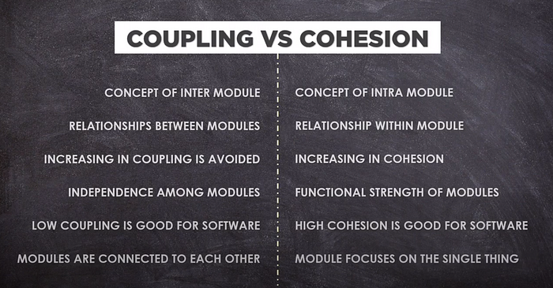
Notes:
A 10 iteration loop will be titled the same way (line 1), regardless of the commands in the loop block.

Slide 16
Additional information
Cohesion and coupling: write BETTER PYTHON CODE Part 1
https://www.youtube.com/watch?v=eiDyK_ofPPM&t=0s
Cohesion & Coupling in Python
An Explanation of the Two Important Quality Metrics in OOP
https://python.plainenglish.io/cohesion-coupling-in-python-f332da3745f8
Notes:
Notice that
the loop block (lines 3-5) contains only program-related commands and no loop-related command. This way, we won’t accidentally omit to increment the counter or perform any other loop-related statements.
"i" is initialized in the loop header (line 2). Therefore it does not need to be initialized in a declaration.
In that case, i will be unrecognized when used outside the loop
(compile-time error).
Q: Why does result need to initialized upon declaration (line 6)?

